Slide 1
Lab 6 Furnitures using Array Lists

Slide 2
Sample Program Output
Press a to add furniture
Press s to show all furnitures
Press q quit program
> a
Enter furniture name: chair
Enter furniture price: 150
Enter designer's name: ikea
Furniture added: [chair, 150, designer=ikea]
Press a to add furniture
Press s to show all furnitures
Press q quit program
> a
Enter furniture name: desk
Enter furniture price: 780
Enter designer's name: crate and barrel
Furniture added: [desk, 780, designer=crate and barrel]
Press a to add furniture
Press s to show all furnitures
Press q quit program
> a
Enter furniture name: TV
Enter furniture price: 3400
Enter designer's name: Samsung
Furniture added: [TV, 3400, designer=Samsung]
Press a to add furniture
Press s to show all furnitures
Press q quit program
> s
List of furnitures:
[chair, 150, designer=ikea]
[desk, 780, designer=crate and barrel]
[TV, 3400, designer=Samsung]
Press a to add furniture
Press s to show all furnitures
Press q quit program
> q

Slide 3
How to store all furnitures?
Store all furnitures entered by the user in an array list: ArrayList<Furniture> furnitureList = new ArrayList<>();
You can use add() method to add a funiture to the array list.
For example students.add(s) adds student s to the array list students.
You can print array list’s contents using for-each loop
Sample for-each loop for students: for (Student s : students) // students is an array list, or an array System.out.println(s)

Slide 4
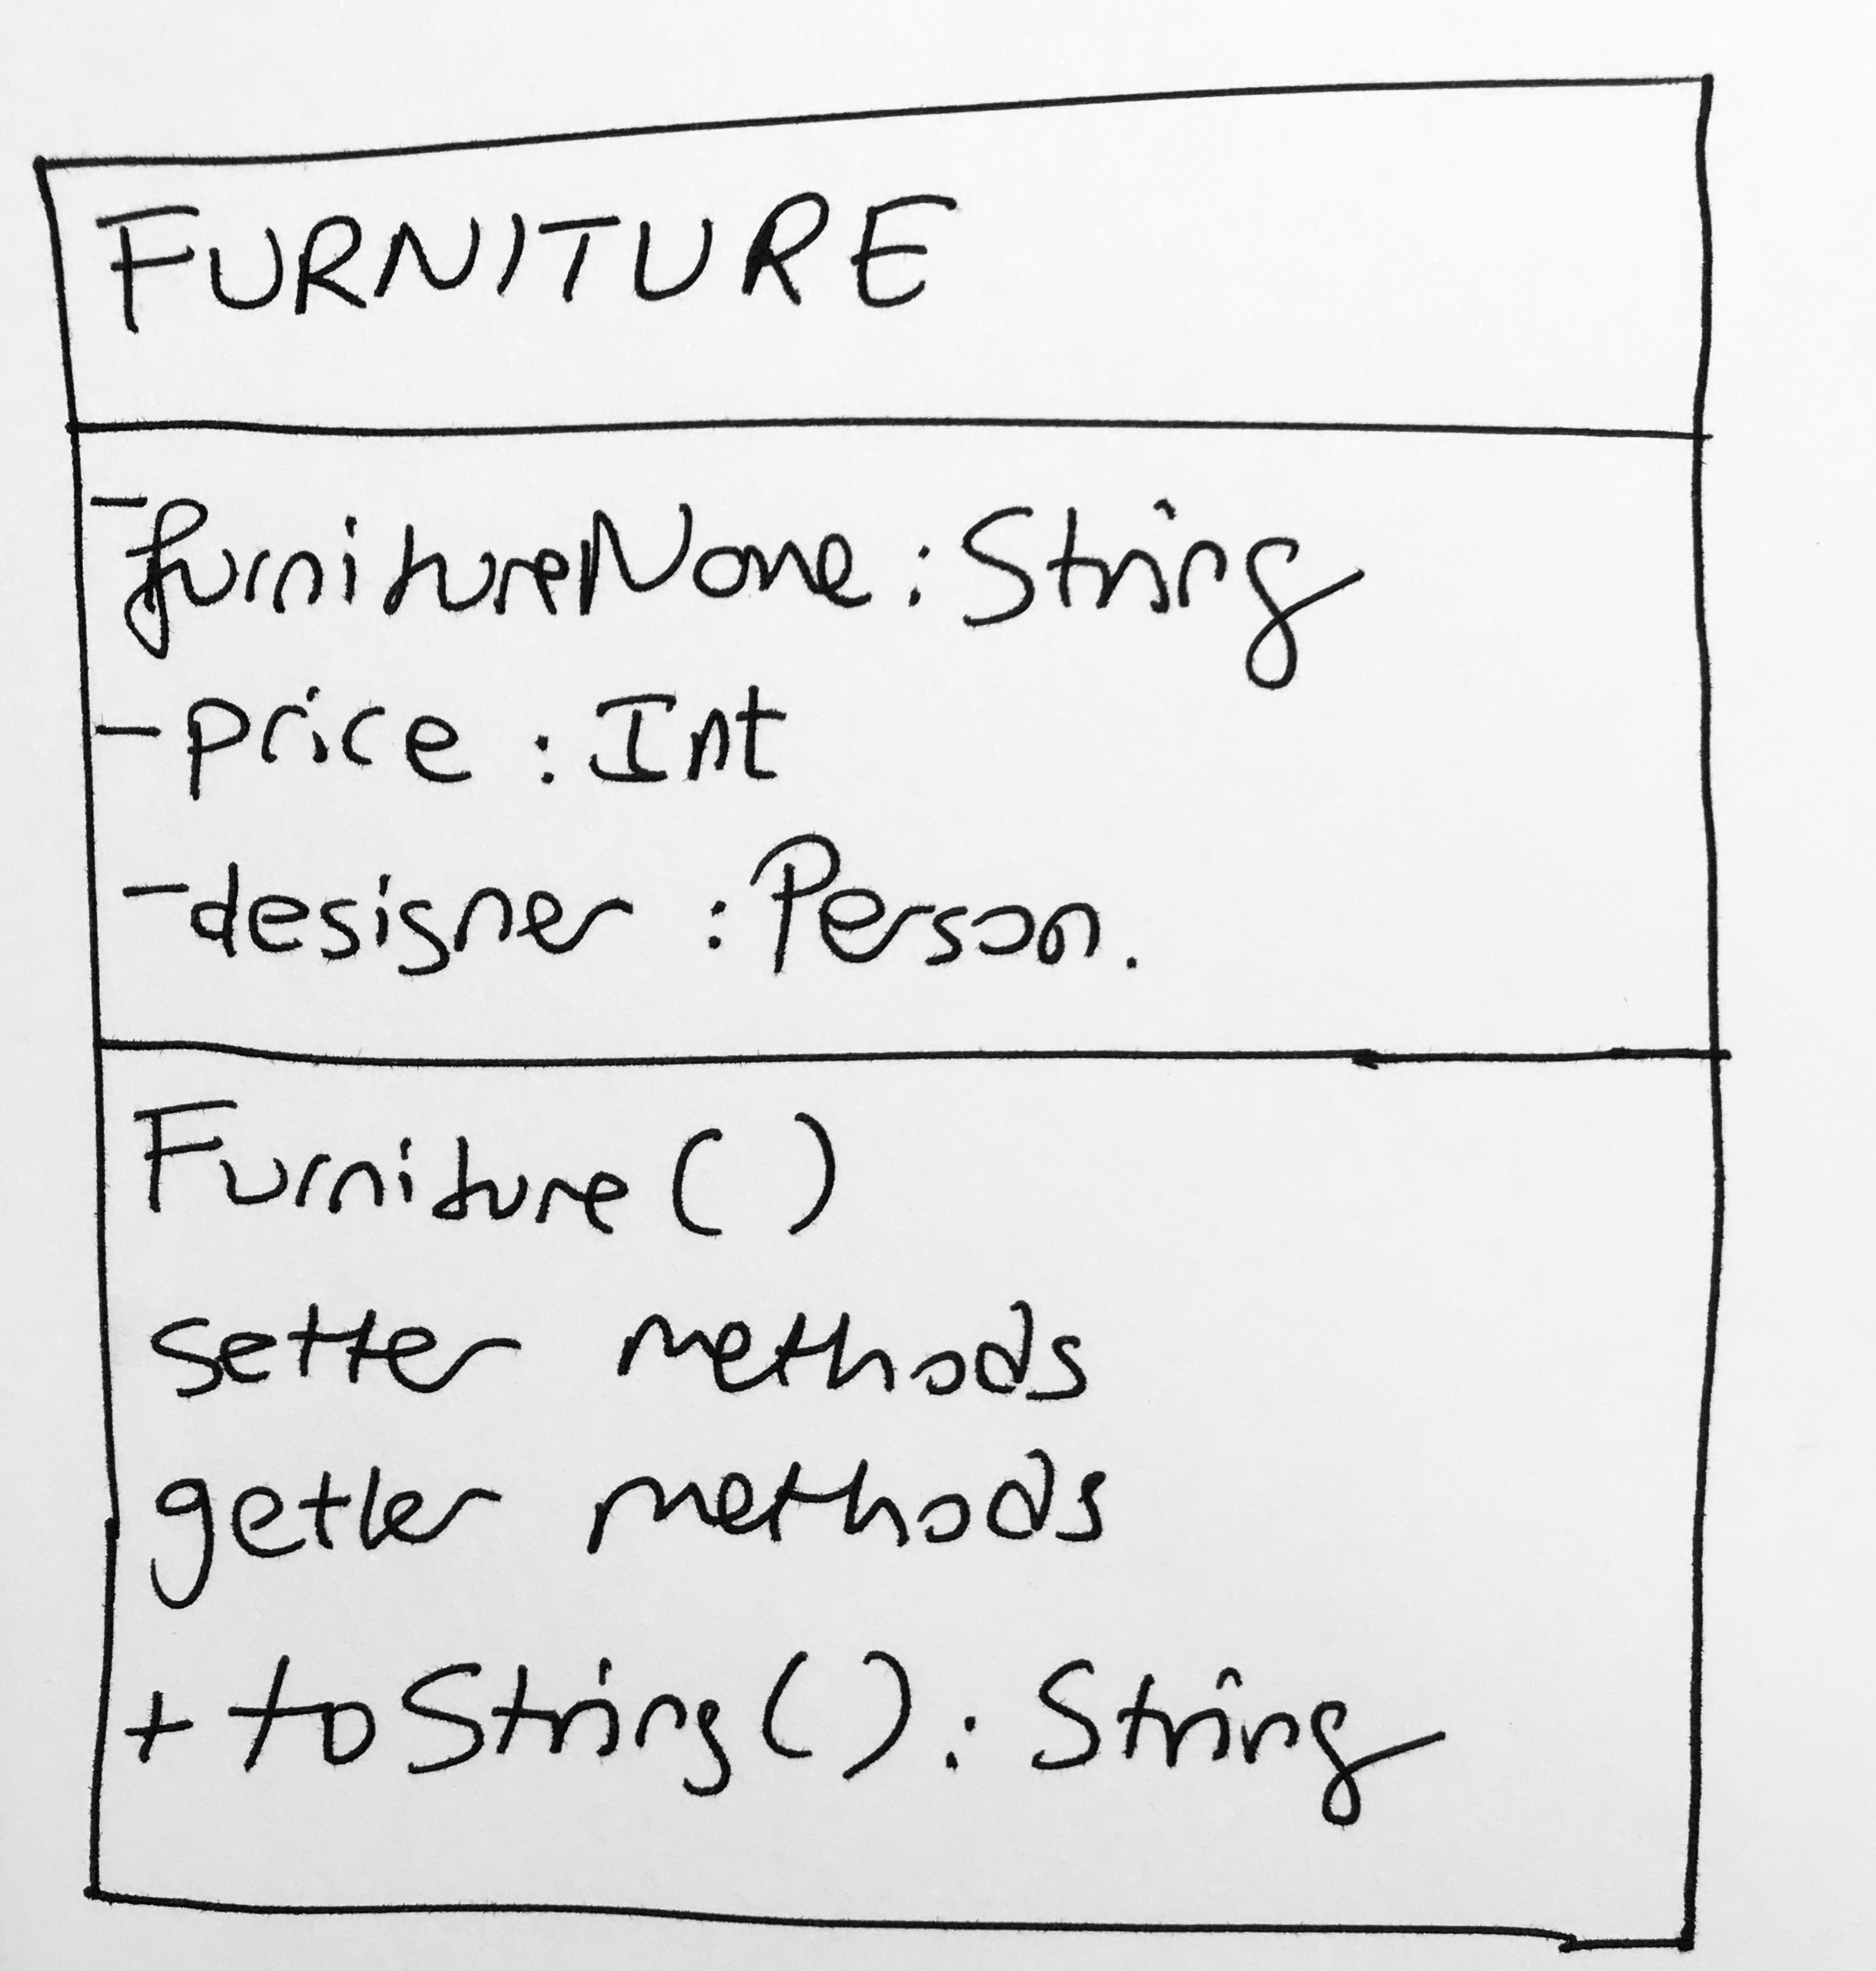
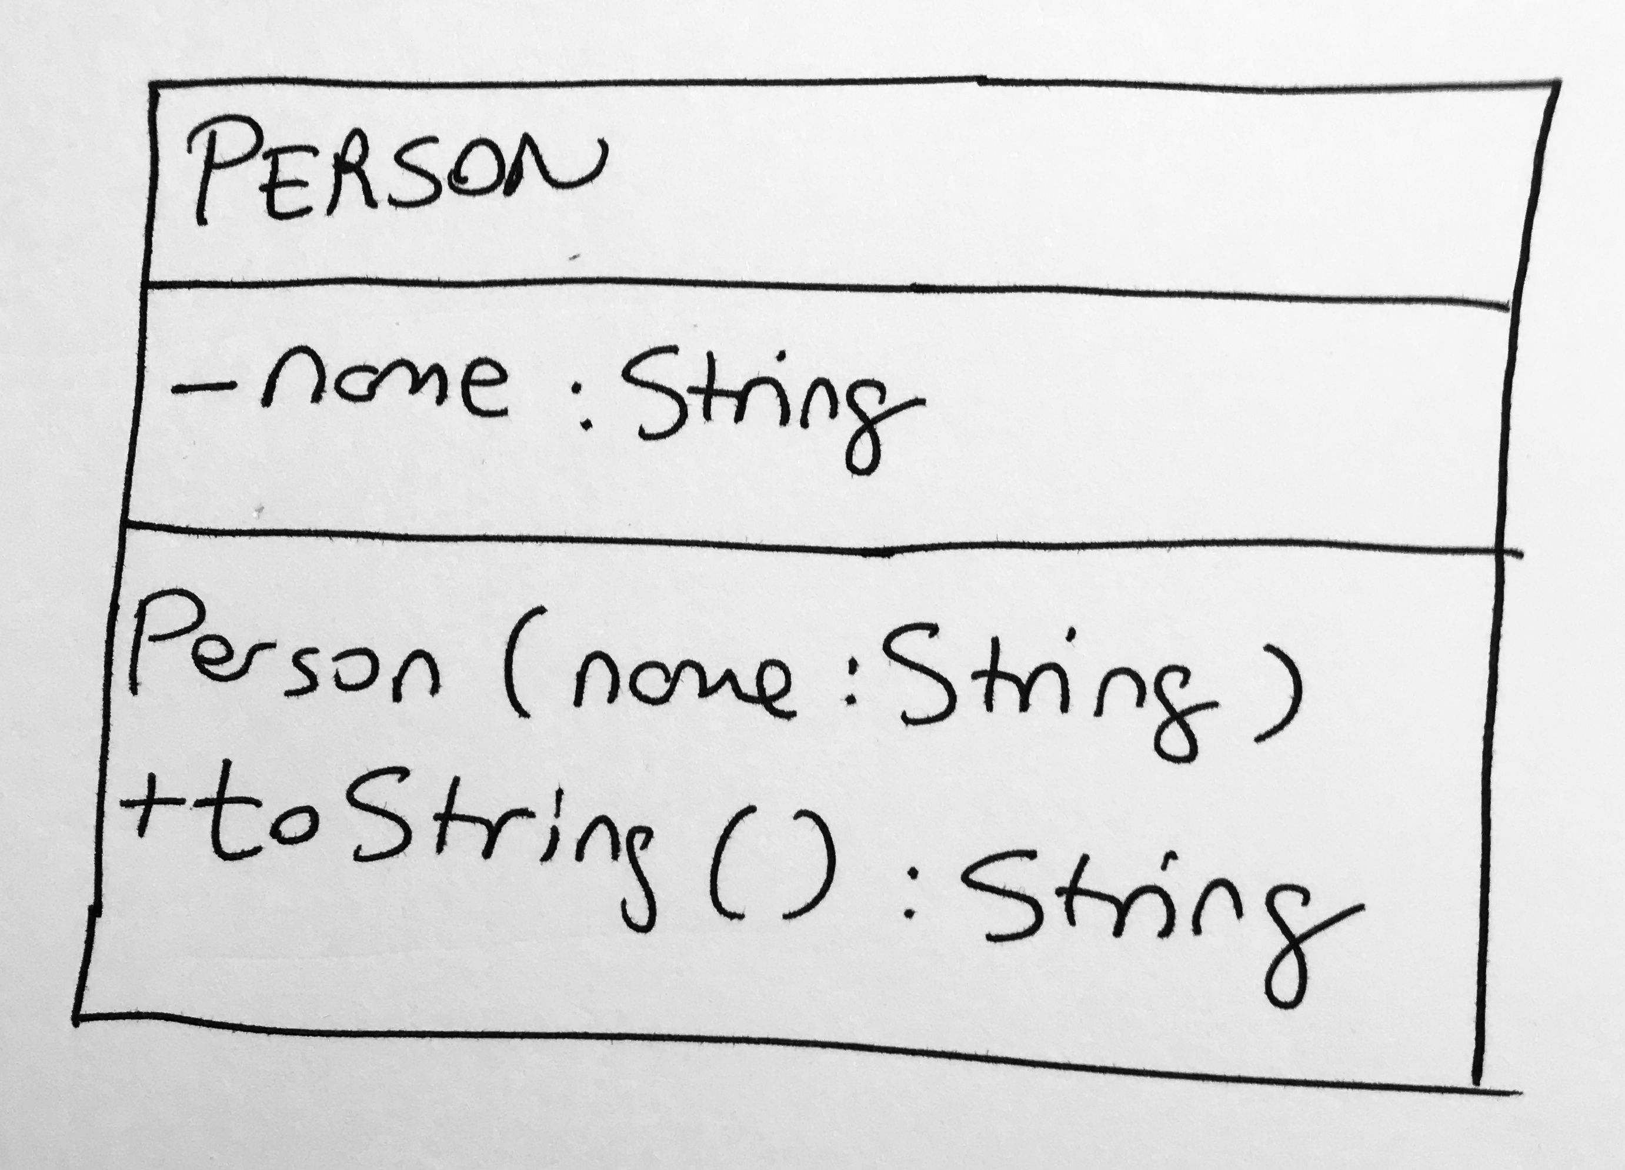
Furniture and Person Classes

Slide 5
Sample Main Code
public class AppFurniture {
public static void main(String[] args) {
ArrayList<Furniture> furnitureList = new ArrayList<>(); while (user continues to add new furniture) {
System.out.println("Press a to add furniture");
System.out.println("Press s to show all furnitures");
System.out.println("Press q quit program");
System.out.print("> "); if (user input is q)
{ // exit }
if (user input is a)
{ // get furniture details from the user and add to the array list }
if (user input is s)
{ // Show all array list contents using for-each loop }
} // while loop ends
} // main
} // App

